Slide 1
CYBER•TECH
Let’s get to it

Slide 2
Agenda
Lesson: Virtual Machines
Exercise: Setup an Ubuntu 20.04 VM
Practical: Wireguard VPN

Slide 3
LESSON

Slide 4







WEB
BROWSER
CODE
SERVER
CLIENT
Notes:
How do you see a website?
What happens if you click youtube.com is:
Your web browser (Chrome, Firefox, Safari, Opera, Brave, Tor) sends a request to YouTube’s servers
A server is just another name for a computer. Your laptop is a computer, a desktop is a computer, a servers are computers that typically don’t have screens
The code that is found on the server is sent back to you.
Your web browser renders the code and shows you an text, images, videos etc.

Slide 5
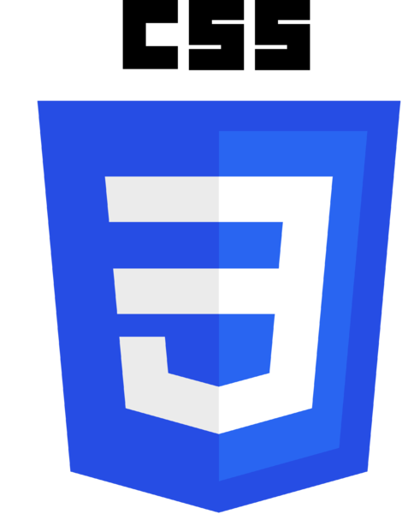


SERVER
CLIENT
Notes:
Front End Code
What I said earlier about the server sending its code back to you, that’s only part true.
In reality, the server will send you what is called Front End code. The front end code for a basic website is typically comprised of three things
HTML – Markup (Converts text into something that is formatted)
CSS – Style(sheet) language (Adds colors and makes the text look pretty)
Javascript – Scripting (Performs calculations)
You can check the code itself with inspect element. This only works because this type of code is front end.

Slide 6
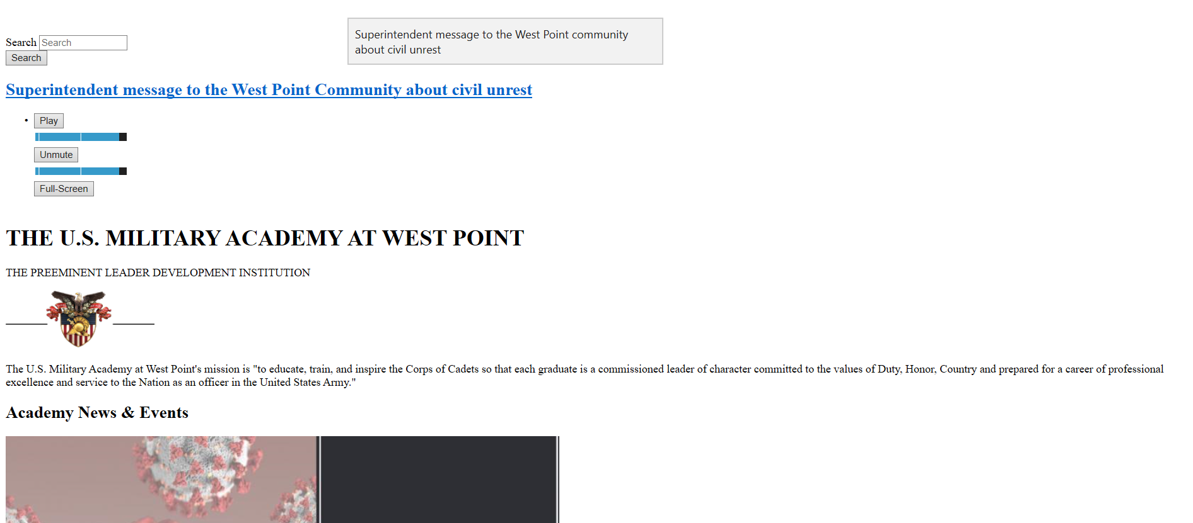

Without CSS
With CSS
var d = document;
for (var s in S = d.styleSheets) S[s].disabled = true;
for (var i in I = d.querySelectorAll("[style]")) I[i].style = "";
https://cavalierchallenge.com/
Notes:
https://cavalierchallenge.com/
var d = document;
for (var s in S = d.styleSheets) S[s].disabled = true;
for (var i in I = d.querySelectorAll("[style]")) I[i].style = "";

Slide 7








Notes:
Back End Code
Meanwhile, there is still code that the server keeps and uses for other stuff, hence backend
Database – mySQL, mongoDB
Make the website look pretty and do stuff (interact with the database, make the website interactive) – PHP, Ruby, NodeJS, Laravel, Django

Slide 8
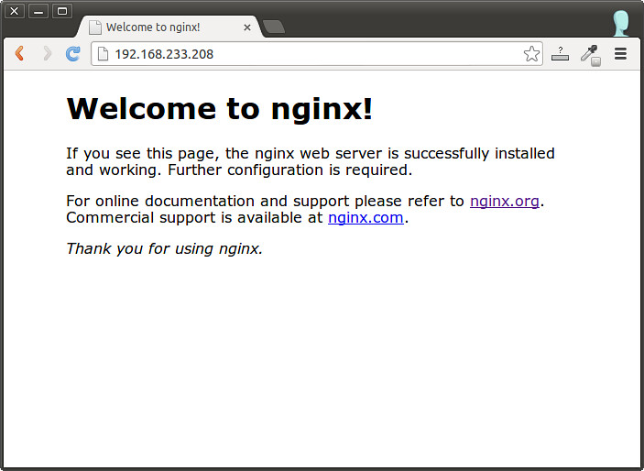
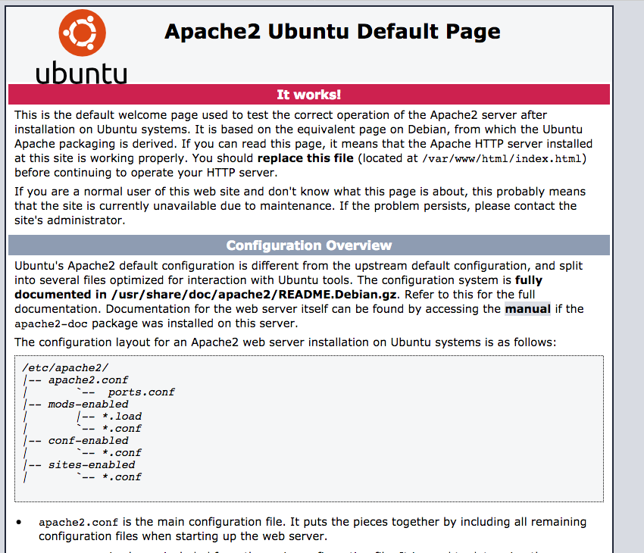
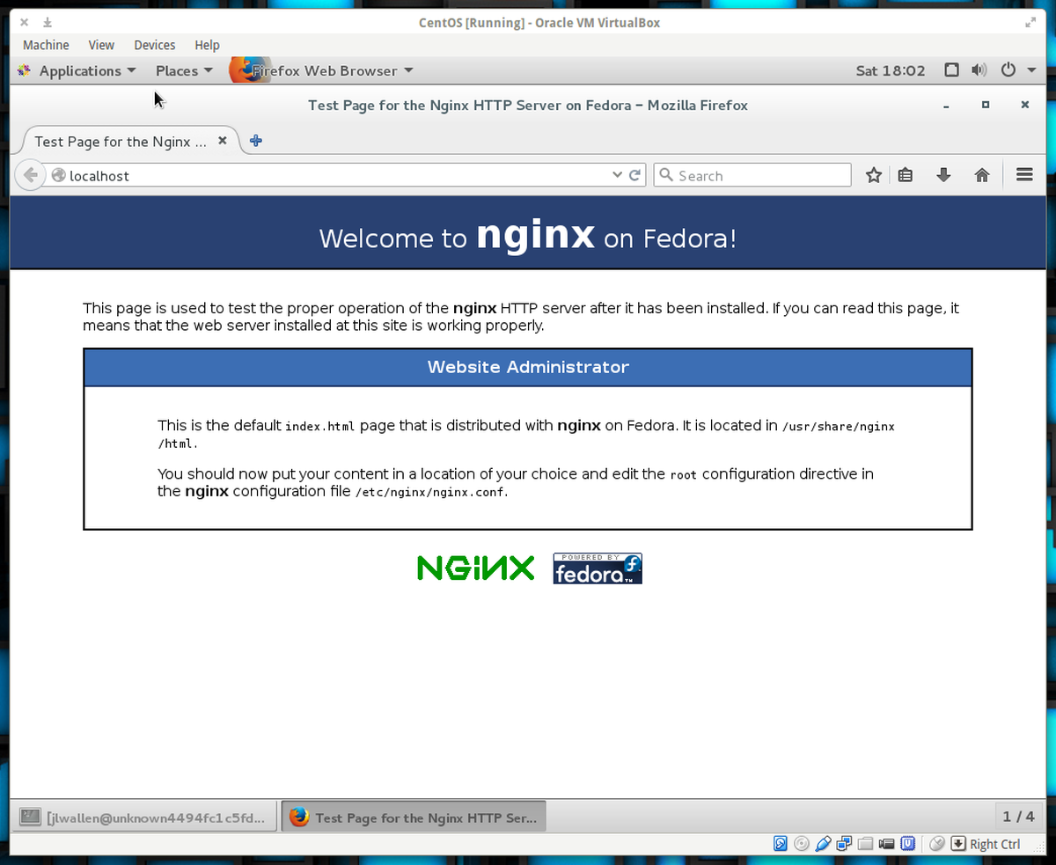
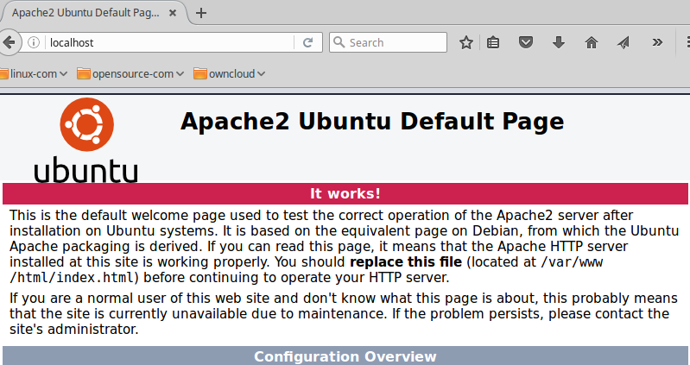
Notes:
Package all the code (front & backend) in one place to deliver to users – Apache, Nginx
Most beginning

Slide 9
EXERCISE

Slide 10
PRACTICAL

Slide 11


Slide 12

Practical Resources
XAMPP
LAMP web dev for Windows
XAMPP Tutorial
How to begin with XAMPP
Bootstrap
Make your website look better than CSS
W3Schools
The foundational resource for web dev
Meteor
You might learn this for CY355
Django
You will learn for IT392
Atom Text Editor
One of many coding environments
Web Exploitation
Intro into Web Exploitation

Slide 13
Works Cited
https://medium.com/@sagarajkt/the-fundamentals-of-front-end-and-back-end-development-5973ac0910cf#:~:text=Front%2Dend%20is%20also%20referred,HTML%2C%20CSS%2C%20and%20JavaScript.
https://css-tricks.com/that-time-i-tried-browsing-the-web-without-css/

Slide 14
Lessons
Website
Lessons
Photos about SIGSAC
Videos about SIGSAC
Logo
Meeting
Presentation – 10 minutes
Exercise – 35 minutes
Practicable Application – 15 minutes

